Slide 1
FLASK WEATHER REPORT APPLICATION WITH OPENWEATHER API PROJECT DESCRIPTION

Slide 2
PROJECT DESCRIPTION:
In this project, you will create a simple web application using Flask that allows users to get weather reports for a specific location using the OpenWeather API. This application will provide users with upto-date weather information such as temperature, humidity, wind speed, and conditions for a given city or location. ( 5 days weather report

Slide 3
TABLE OF CONTENTS
01
02
03
04
ABOUT API
EXPLANATION OF CODE
OUTPUT
DISCUSSION OF PROJECT AND LAYOUT OF PROJECT

Slide 4




ABOUT API
Application Programming Interface (API), often referred to as web API, is an interface that allows two systems to communicate with each other
Example:
In hotels we order the food to server they only say to chief so here client is a user and server is a chief and intermediator is a server

Slide 5
USING LIBRARIES ARE:
datetime
requests
string
os
Framework:
Flask
Templates – html
Static - css

Slide 6
EXPLANATION OF CODE:
In this project we are goin to see about the weather to calculate in 5 days with various cities. Using flask in python and openweather API is a free accessing weather website.
With the help of API key to give weather according to the days
Display date and time using datetime library
Data retrieved from the API is processed and formatted to display on the web page.

Slide 7
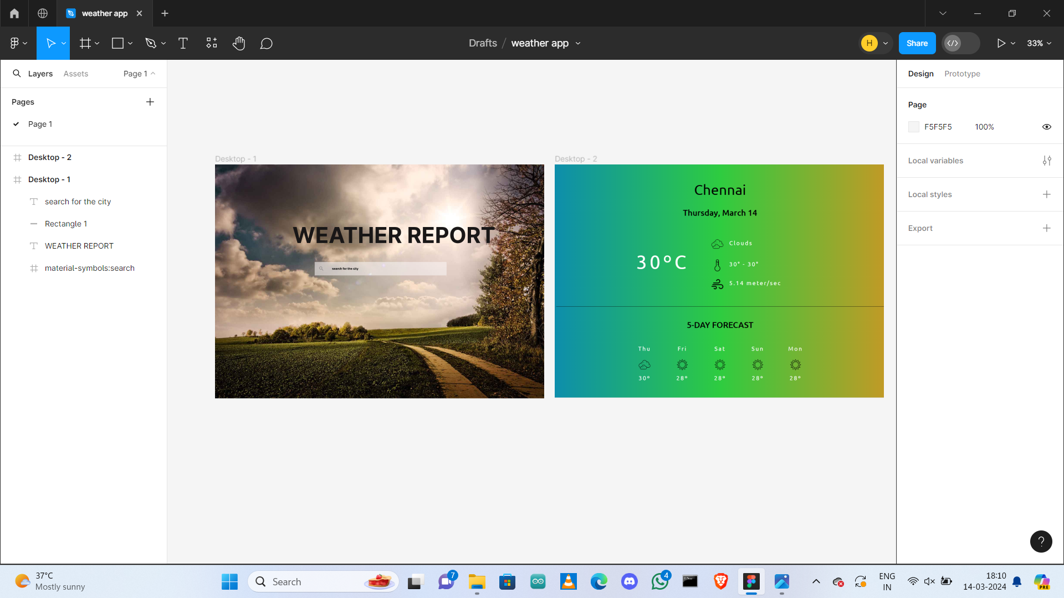
OUTPUT:

